Slide 1
Job Corps Scholars Applicant Background Check Process Training
December 2020

Slide 2
Introductions
Moderator: Michelle Mills- Ajayi, Program Manager
Office of Job Corps - Division of Policy, Communication, and Planning
Main Speakers:
Daunta Hall, Physical Security Specialist
Office of Job Corps - Regional Operations and Program Integrity
Cordenay Franklin, Personnel Security Specialist
Office of Job Corps - Regional Operations and Program Integrity
Notes:
MICHELLE:
Thanks for joining today’s session to discuss the applicant criminal background check process. Before we get started, please note that this session will be recorded. For quick introductions, my name is Michelle Mills and I am your new POC in the Office of Job Corps’ policy, communication, and planning division providing programmatic and policy oversight of the grant. I previously was working in the office of apprenticeship managing a grant portfolio of approximately $100 million, acquired experience also in the Department’s international bureau working on developing policy recommendations on labor compliance for multiple countries. I also have experience as a practicing attorney. I am thrilled to provide support to this project and look forward to learning more about the great work you will do under this grant.
Today we have our experts from the regional operations and program integrity division to provide a training on the background check process so you can know what to expect and plan your timelines and action plans accordingly. Daunta Hall is our Physical Security Specialist and he and is team will walk us through the agenda and towards the end we will take questions. Feel free to also put questions in the chat.
Daunta, take it away.
Transition over to Daunta.

Slide 3
AGENDA
To provide an overview of the Job Corps Scholars Applicant Background Check process.

Slide 4
Background
The Job Corps scholars program is a new initiative in which Job Corps collaborates with colleges and universities to provide grants to qualified students.
Key requirements for participation include:
Adherence to job corps enrollment standards as out lined in PRH 1.2.
Requesting user accounts through OJC National Office.

Slide 5
Requesting Credentials
Participants will request credentials by submitting an email to OJC-PSS.GOV providing the following information:
Requestors Name and Title:
Organization:
Grant Number:
Each organization is limited to three user accounts.
There are no shared accounts.
All request must come thru the OJC-PSS Inbox.

Slide 6
Credentials Continued
The OJC National Office will validate your request.
The OJC National Office will submit your information to the programs service provider, MYB, who will create a user account for the requested users.
MYB will provide users with a username and password.
MYB will provide technical support for users.
The OJC National Office will provide a copy of the MYB system user guide and frequently asked questions.

Slide 7

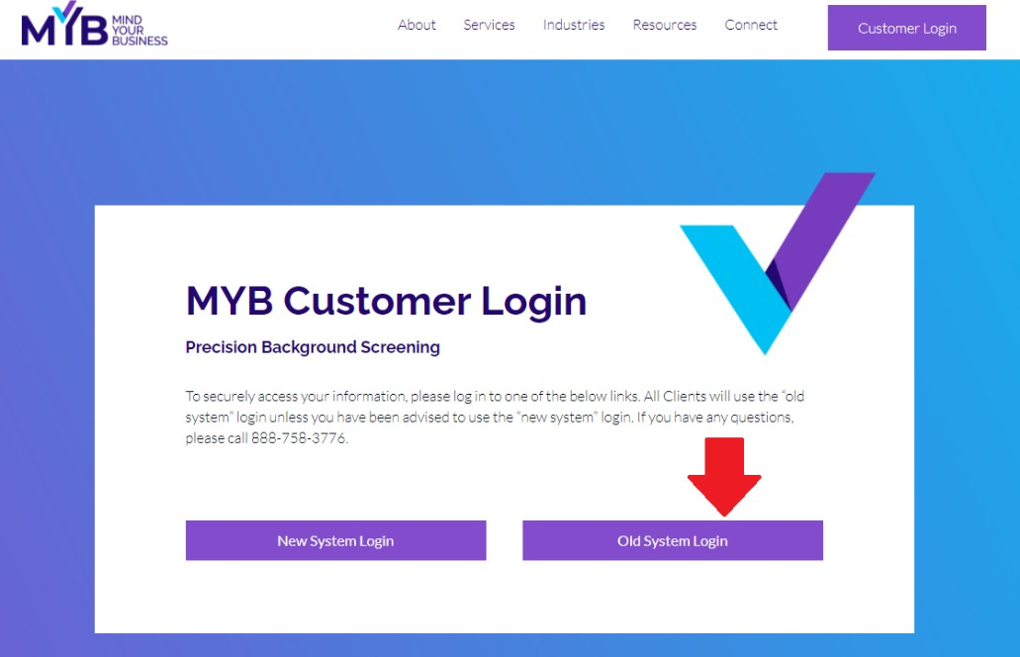
To enter a new request:
Please start by going to www.mybinc.com
Our website is where you will login to begin the request process. Click the Customer Login button. If you are taken to a screen with options for New System Login or Old System Login, you will select Old System Login.

Slide 8
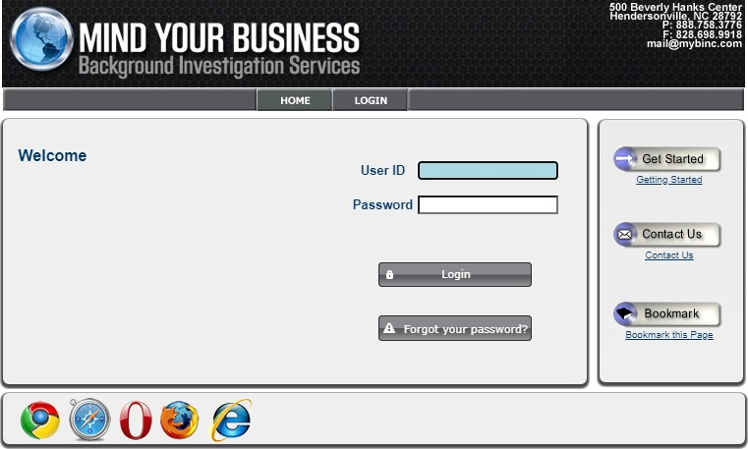
You should have your user id and password available to key in. These were emailed to you via separate emails.
Enter in your User ID and Password here.
The first page you will see is our “General Information” page. This page supplies updates, court closures, fee changes and other pertinent information that we wish to relay to our web clients. Please note that most of this information will not impact DOL-OJC users.
Please note that there will be a “Warning Banner” specific to DOL OJC users that you should pay pay
close attention to.

Slide 9
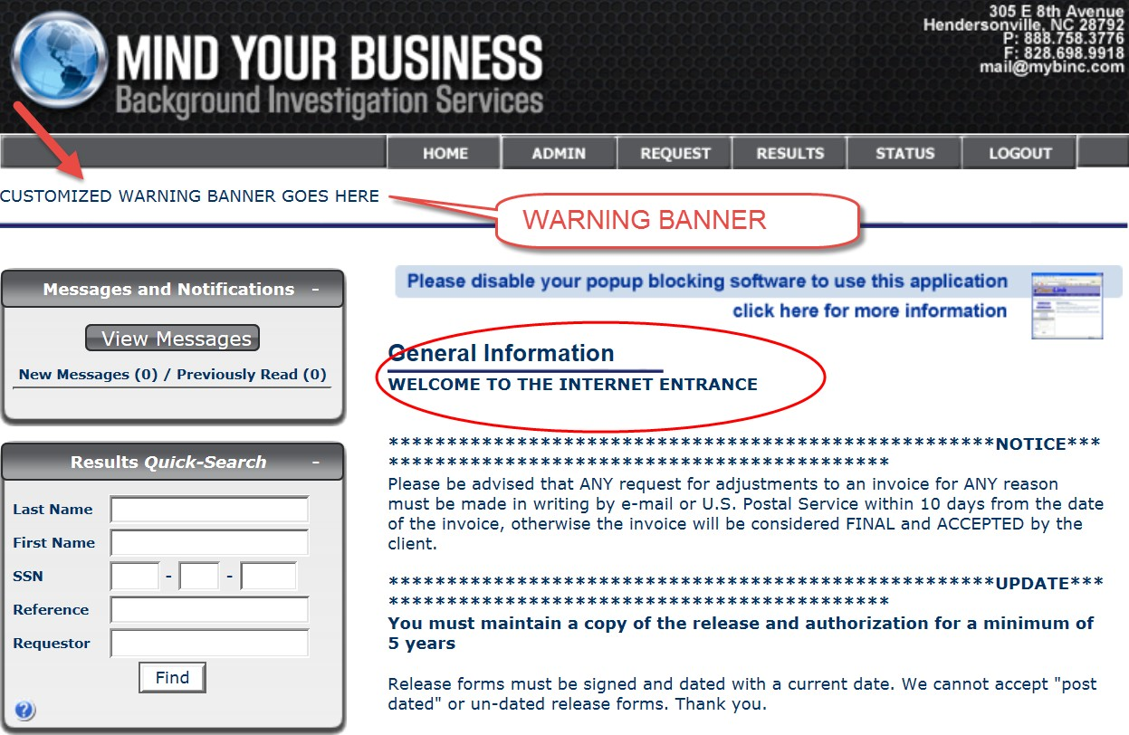
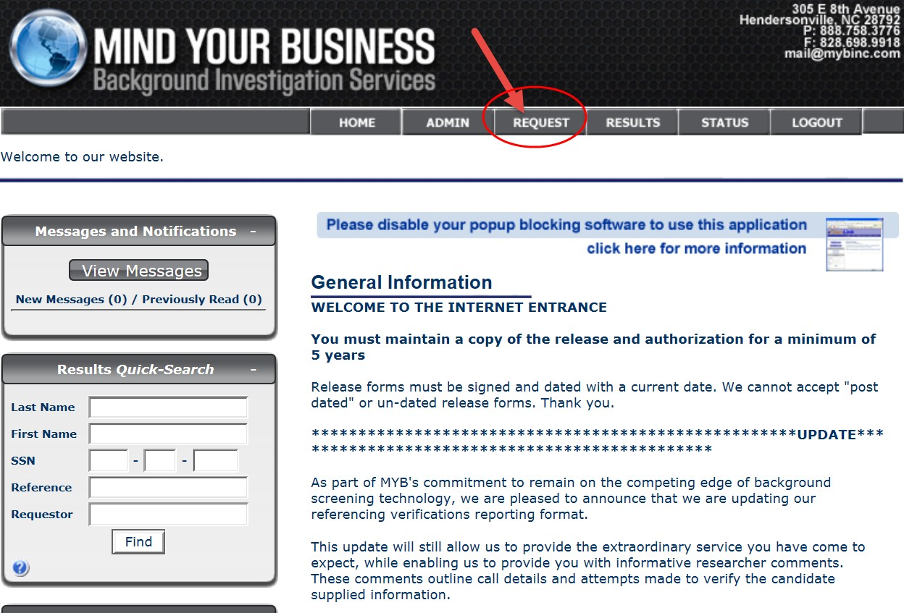
From the General Information Page, please select the Request tab.

Slide 10
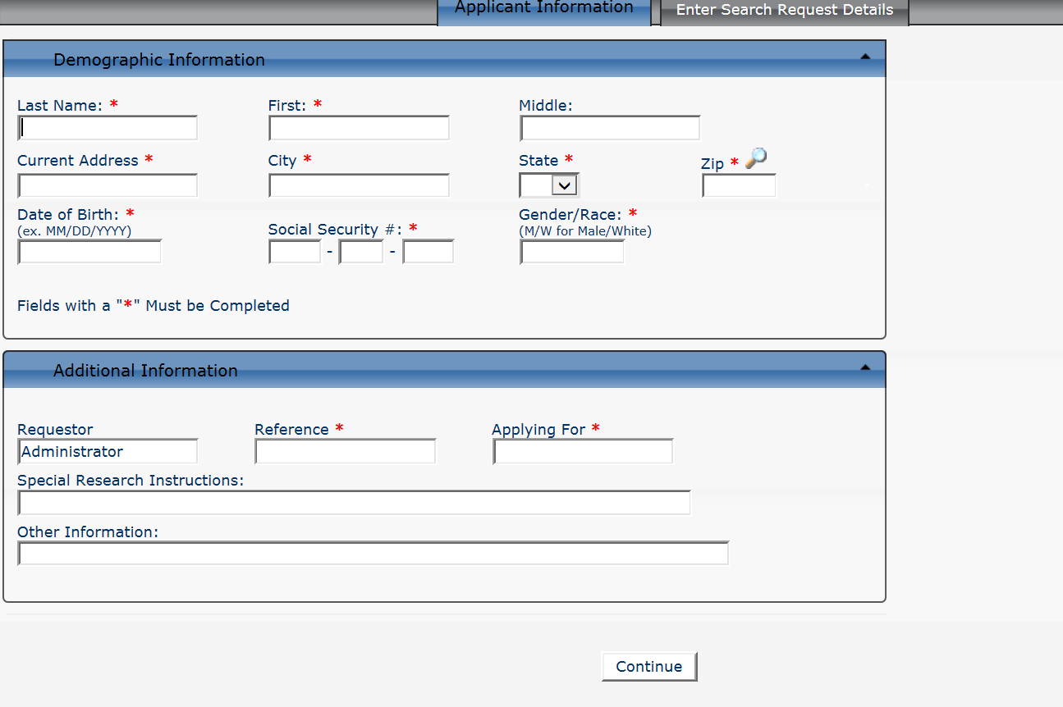
The Request tab will take you to the Applicant Information page. Here you will need to provide the required Demographic Additional Information. The Reference field is used to indicate your own tracking number or the student ID for your institution and the Applying For should indicate "OJC Scholar". Any field designated with a red asterisk (*) is a REQUIRED field. Once all information has been completed you will need to click on the Continue button.
In the event you forget to supply any required information, you will be alerted with a pop-up and the missing fields will be highlighted.
If your applicant does not have a middle name, please enter NMN this is the abbreviation for NO MIDDLE NAME.

Slide 11
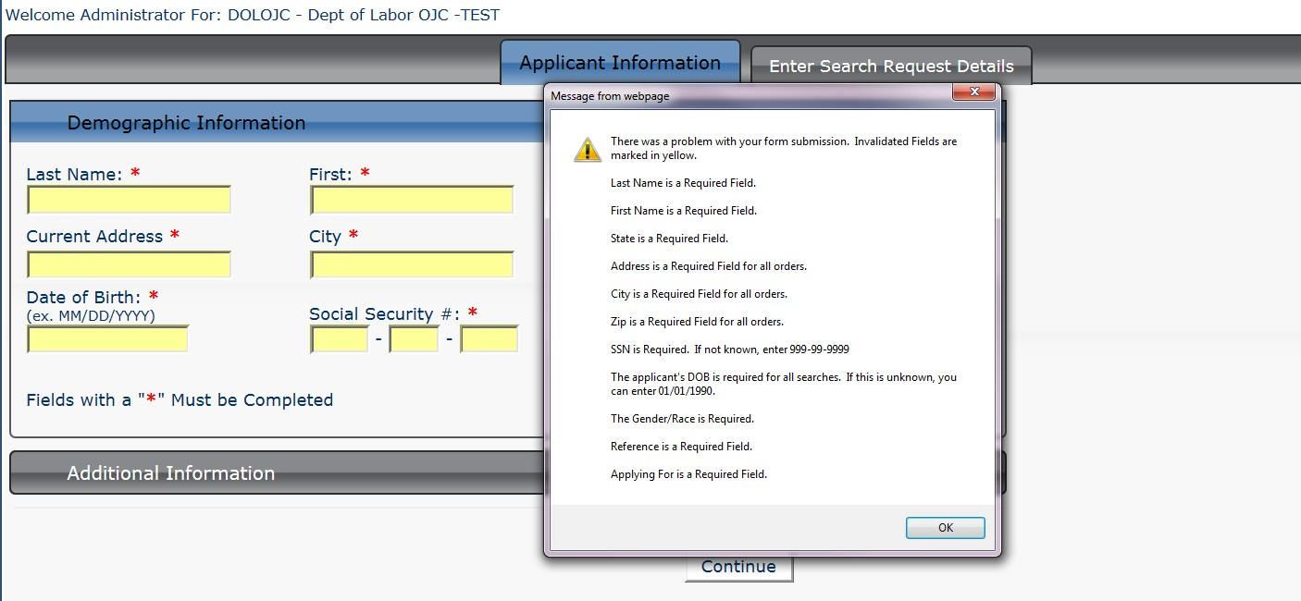
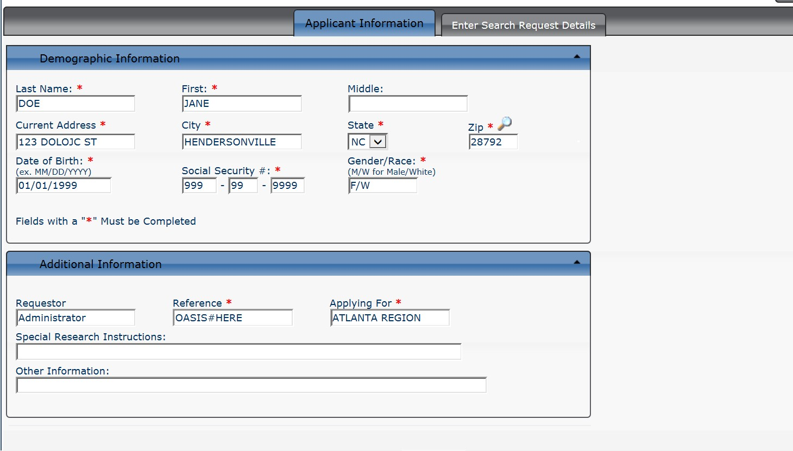
SAMPLE COMPLETED VIEW

Slide 12
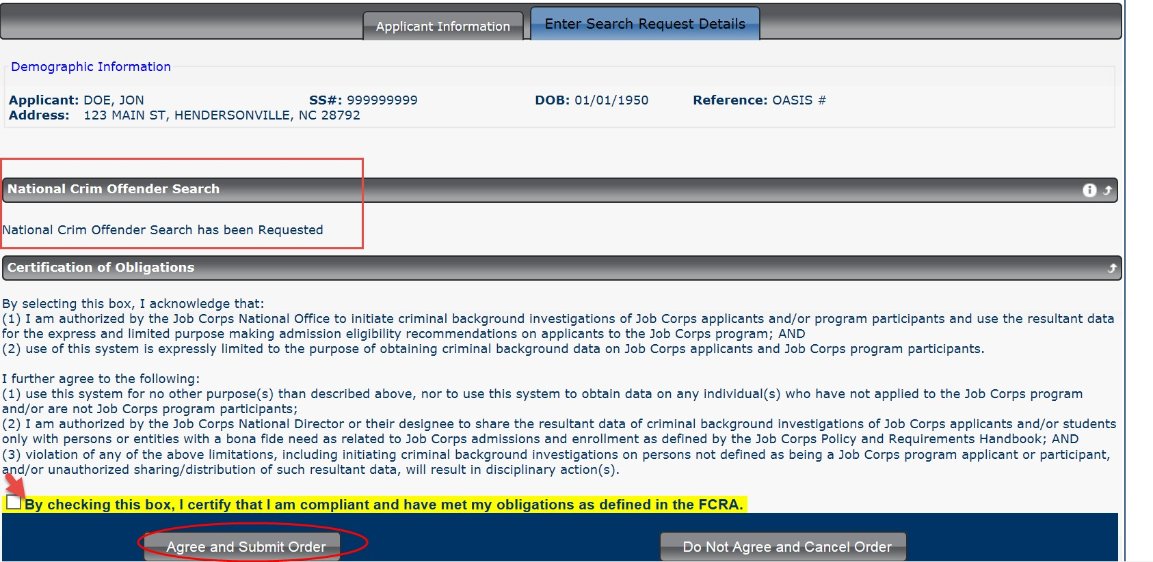
Once you have clicked on the Continue button, you will be directed to an order confirmation page, this will indicate what has been ordered for your applicant and you will need to check the Certification and Obligation box (shown with a yellow highlight) and click agree and submit the order to begin the background check.
You will receive a confirmation page that can be saved or printed for your records. This verifies that the order has been submitted into the work que for processing.

Slide 13
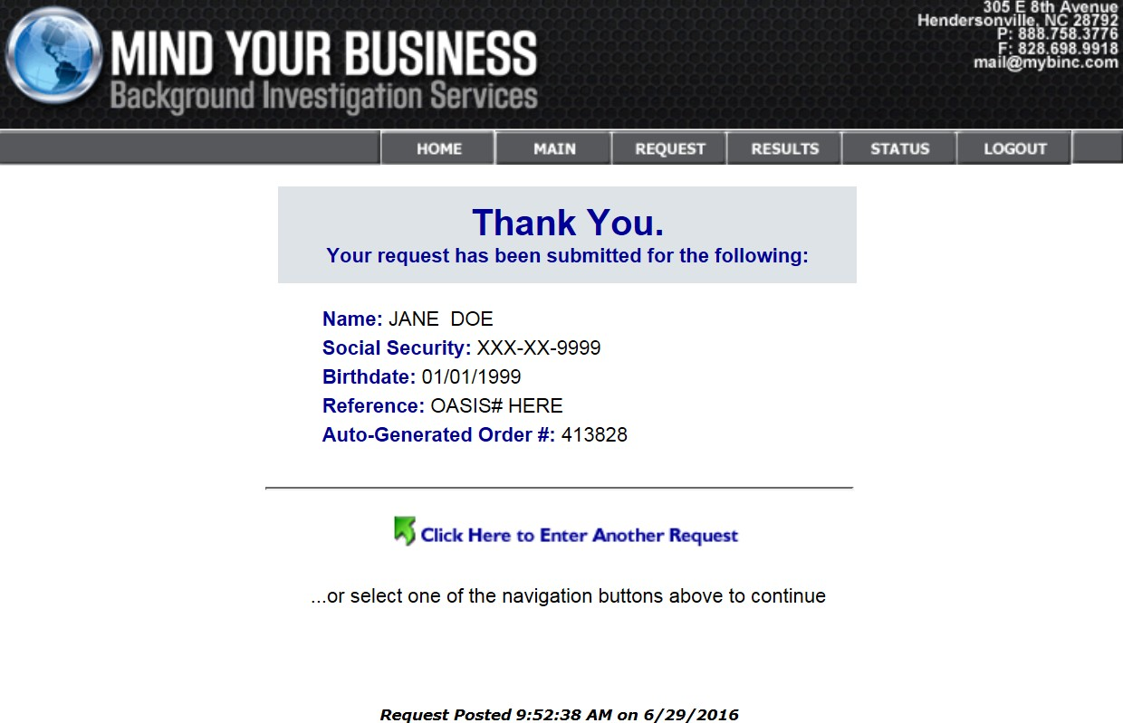
Incoming requests are then processed and returned typically within 24-72 business hours, Monday through Friday 8:00 am until 7:00 pm Eastern Standard Time, excluding weekends and Federal holidays. If there are court delays, the MYB team will notify you. The turnaround time will also depend on how accurately the candidate information is keyed into the system.
To View Results
Login into to MYB from www.mybinc.com with your user id and password. To view results for candidates previously submitted. Click on the Results tab at the top of your main screen.
You can also search by name and or social security number by entering the information in the quick search field.

Slide 14
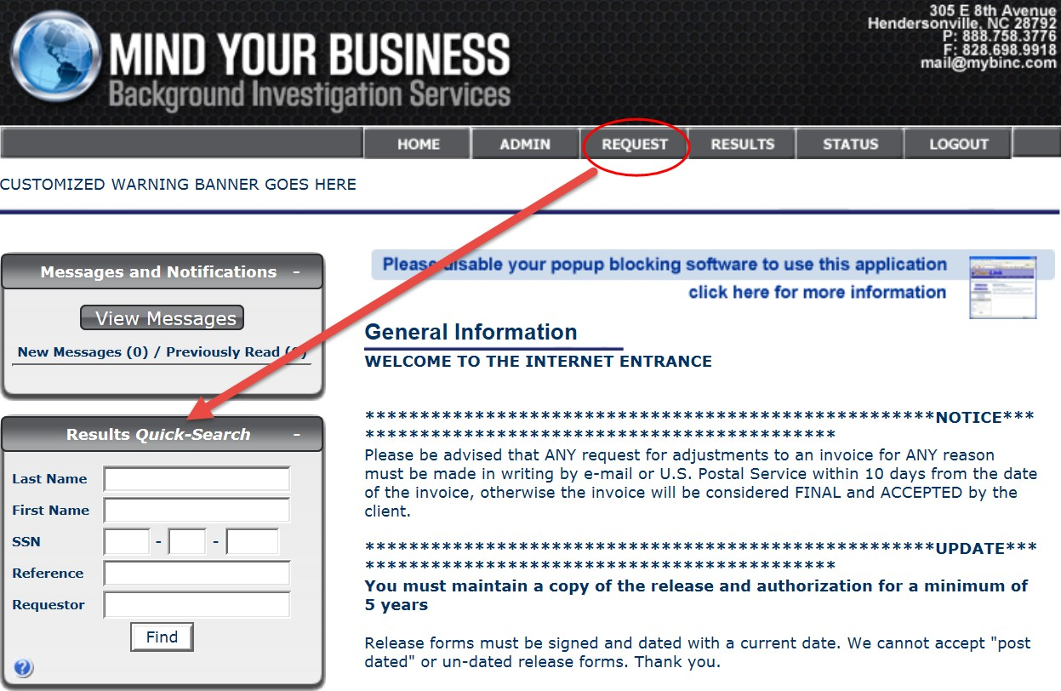
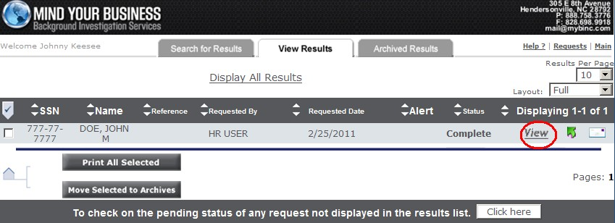
To view the report – be sure that all pop-up blockers have been disabled. Then click on the View link area.
Your report will then “pop-up” in a new screen to be printed.

Slide 15
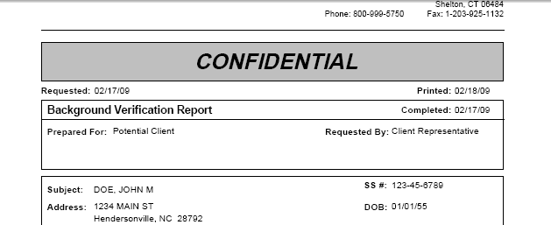
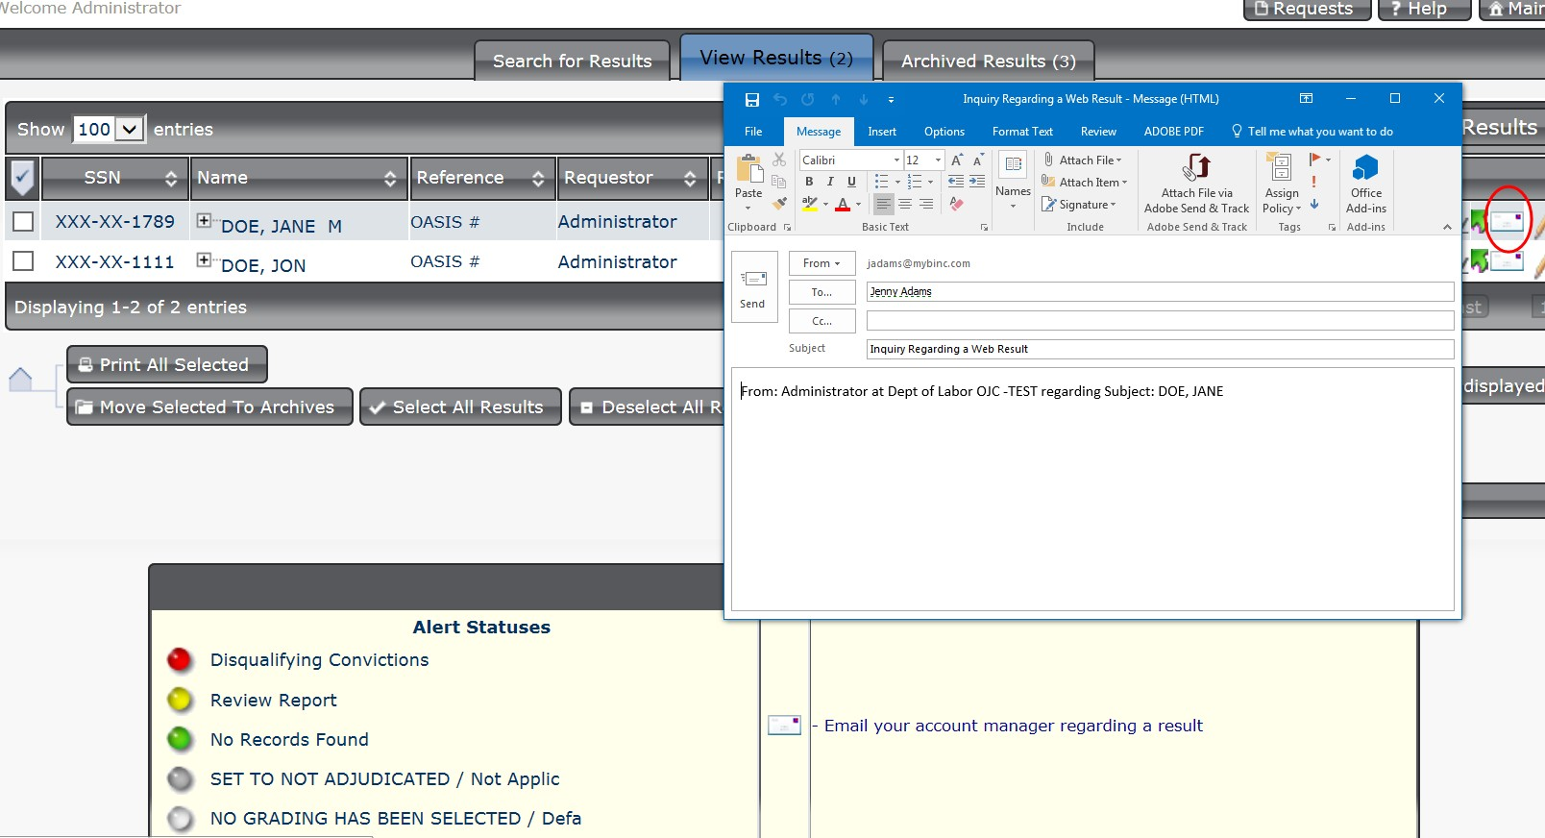
If you have any questions regarding the report, you can email MYB’s customer service team directly from the result area by clicking on the envelope icon, this will provide our customer service team with the name of the candidate and we will be able to respond to your questions in a timely manner. You may also call toll free to 1-888-758-3776. Representatives are available to help you Monday through Friday 8am to 7pm Eastern Standard Time, excluding weekends and Federal holidays.

Slide 16
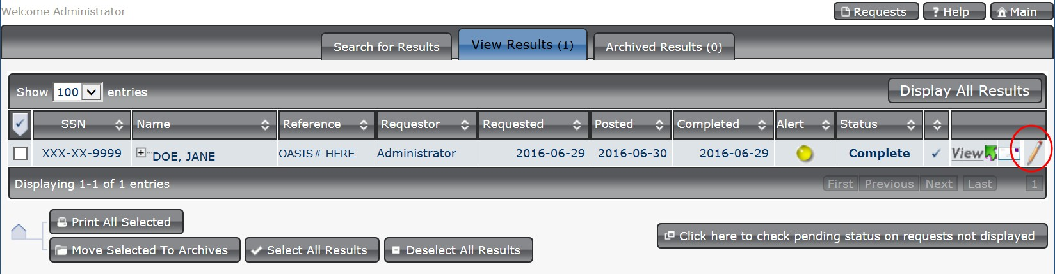
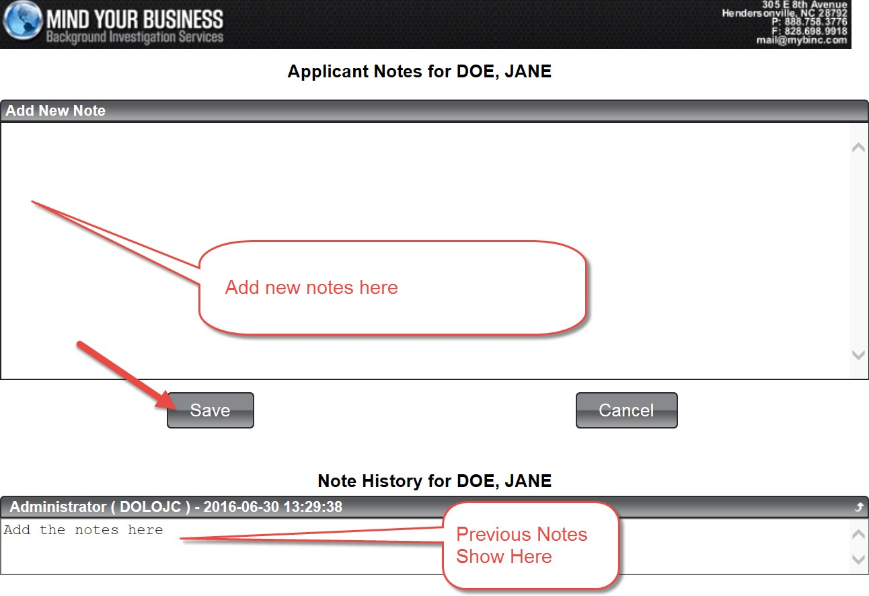
You also have the capability to add additional notes that are specific to the candidate by clicking on the pencil icon. Notes are stored with a date and time stamp. Be sure to click on the Save button when you have finished your note.
MYB has established an Alert System that will aid you in making final eligibility decisions on candidates.
Green would indicate that no criminal records were found that would cause the candidate to be ineligible.
Red would indicate that disqualifying criminal records were found based on the Disqualifying Convictions located in the PRH Chapter 1 and Appendix 103 and that further review by admissions is necessary.
Yellow would indicate that criminal records were found that are questionable and would need further review.

Slide 17
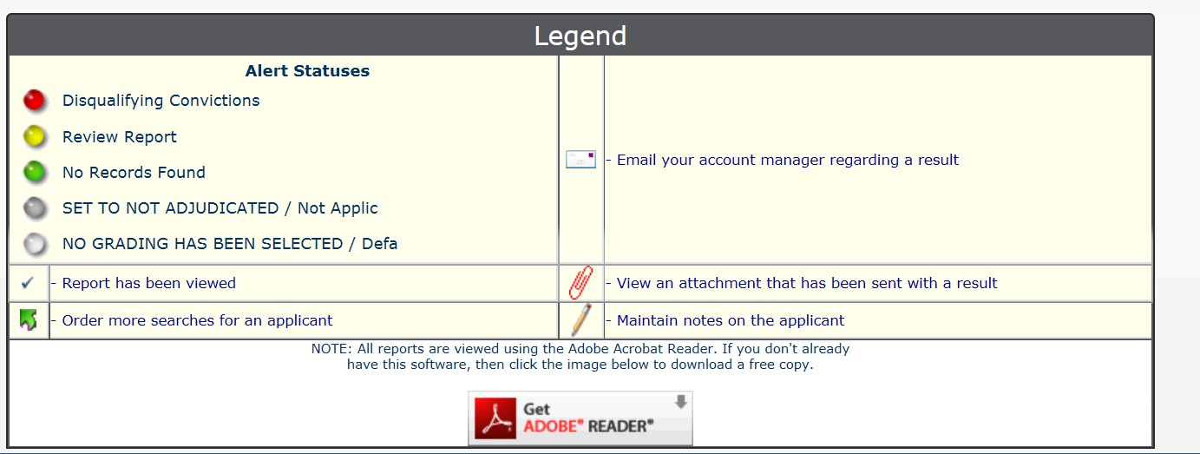
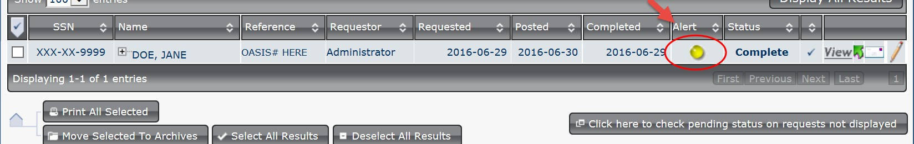
Yellow may also indicate that MYB is in need of additional information.
The status indicator for the candidate is located under the “Alert Section”
Please note, this is a help feature only and MYB will not make any eligibility decisions.
We look forward to assisting you with this program. Again, should you have any questions or need additional assistance, please call toll free to 1-888-758-3776. Representatives are available to help you Monday through Friday 8am to 7pm Eastern Standard Time , excluding weekends and Federal holidays.

Slide 18

MYB FAQ’s – Updated October 2020
1
FREQUENTLY ASKED QUESTIONS (FAQs) FOR JOB CORPS ADMISSIONS OPERATORS
WHAT IS AN “OASIS NUMBER”?
It is the same as the Applicant ID# or Student ID#. This number is generated when you open an application in OASIS, and it is REQUIRED in order to initiate a background check with MYB. The
number is entered into the REFERENCE FIELD of the MYB input screen. No other characters entered in the Reference Field can be accepted. Job Corp Scholars will use the student ID
Number in lieu of the oasis number..
WHAT IS THE TURN-AROUND TIME?
The turnaround time is typically 24 to 72 hours (excluding weekends and when courts are closed); if there are court delays, the MYB team will notify you. The turnaround time will also depend on how accurately the candidate information is keyed into the system by the requestor. Information discrepancies may result in delays.
HOW LONG ARE MY RESULTS AVAILABLE?
Results will be made available on the website for 10 calendar days. You will receive an email notice when the results are posted on the website.
WHAT CAN CAUSE DELAYS IN RECEIVING RESULTS?
  Not supplying the OASIS# (Applicant/Student ID#)
  Entering duplicate searches for the same name
  Making errors during data entry
  Not entering “A.K.A.” names as a separate request (See #7 and #8 below)
  Court closures or delays
  Court-assisted searches
  See 2* above

Slide 19
MYB FAQ’s – Updated October 2020
2
WHAT IF I MAKE A MISTAKE AND I HAVE ALREADY SUBMITTED THE SEARCH?
If you have made any type of typographical error while inputting the information for your candidate and you already have submitted the request, please call or email the correction to the MYB team. We can fix minor errors on our side including middle name, address if in same county, oasis number. DO NOT DUPLICATE OR RE-SUBMIT A NEW REQUEST WITH THE CORRECTED INFORMATION IF THE SEARCH HAS NOT ALREADY BEEN COMPLETED. If the
search has already been completed, we are unable to make corrections, so please initiate a new request and re-enter all candidate’s information correctly. Please note that turnaround time does not start until all information has been supplied correctly.
HOW DO I KNOW IF I HAVE ENTERED A CANDIDATE ALREADY?
The system will alert you when the same exact name and or the same SSN has been previously entered, and will allow you to view the report of that candidate if it is within the 10 days of the
previous report. You can also search by name on the general Information page when you first log in.
WHAT IS AN “AKA” (ALSO KNOWN AS) NAME?
“AKA” stands for “Also Known As.” An AKA Name is a different or other name used in the past or on occasion by your candidate. Example: Richard Jones -aka Richie Jones, aka Rich Jones Example: Mary Adams – aka Mary Jones (maiden name) Example: Jennifer Long – aka Jen Long, aka Jenny Long.
HOW DO I HANDLE AKA NAMES?
True AKA names must be added as a separate request. Please do not put them in the Special Research Instruction field.
WHAT INFORMATION GOES IN THE SPECIAL RESEARCH INSTRUCTIONS FIELD?
Any additional information that may aid in vetting possible criminal records.
  Self-disclosed or known criminal background all information available
  Previous states with counties or zip codes they have resided in
  If they have lived on reservation/Native American lands, complete address during the period they lived there
  Height and or weight if available
  Known tattoos or markings
WHAT INFORMATION DOES NOT GO IN THE SPECIAL RESEARCH INSTRUCTIONS FIELD?
  Information on errors from previous entries
  AKA names

Slide 20
MYB FAQ’s – Updated October 2020
3
11. MAY I USE A DIFFERENT CRIMINAL BACKGROUND SEARCH SERVICE FOR MY JOB CORPS APPLICANTS? OAs are required to use the MYB system for ALL applicants.
12. MAY I REQUEST A CRIMINAL BACKGROUND CHECK FOR SOMEONE WHO HAS NOT INITIATED APPLICATION TO BE A STUDENT IN JOB CORPS? No. OAs/ Requestors may only request, receive, and/or review an individual’s criminal background information in their capacity as an OA/Requestors after the individual has initiated an application with Job Corps or the Job Corps Scholars
program. OAs/Requestors may not request, receive, and/or review an individual’s criminal background information in their capacity as an OA/Requestor before the individual has initiated an application with
Job Corps, as evidenced by an applicant record in the OASIS system. Further, unless otherwise approved by the Job Corps National Office in advance, only applicants who wish to enroll in the Job Corps program
as students may be searched within the MYB system. (For example, Job Corps staff or other non-
students may receive a criminal background check through this dedicated MYB system.)
THIS APPLICANT’S PROCESSING TIME HAS TAKEN LONGER THAN 60** DAYS FROM THE DATE THE COMPLETED CRIMINAL BACKGROUND CHECK WAS PROVIDED TO THE OA BY MYB. DO I NEED TO REQUEST A RENEWED MYB SEARCH? Yes. If 60 calendar days has elapsed since the date of the initial background check and the application is still in progress, another MYB background check must be requested. If the application file has already been submitted to the receiving Job Corps center, and the student has not arrived within 60 days, the OA/Requestor must initiate a renewed background check with MYB. Requests for renewed searches may be sent directly to MYB, who will share instructions for the DOL approval process, or they may be sent directly to the Job Corps National Office by email (OJC- PSS@dol.gov). You must include in your request: Type of request (Renewed Search), Date of First MYB report (the date that appears on the report itself), detailed reason for the delay, name and contact
information of requestor, name and contact information of the contract’s OA/Requestor Manager. The Job Corps National Office will review that information, and you may receive follow-up questions.
Approvals are sent by email from the Job Corps National Office to MYB, and OAs/Requestors are copied in those approvals. Please pay attention to any special instructions.
I CANNOT ACCESS THE REPORT THAT MYB PROVIDED TO ME OR TO ANOTHER OA. WHAT SHOULD I DO? The process is very similar to the steps highlighted in red above. The Type of request
will be a “Repost.” The MYB reports that are completed and posted on the MYB website for your access will be available for up to 10 calendar days. You will have 10 days in order to access them, and print or archive them in your electronic files, or both, and made a part of the applicant’s file. OAs/Requestors who are out of office should ensure that their OA/Requestor manager is monitoring receipt of MYB reports in order to access and download the reports within the required 10 calendar days.

Slide 21
MYB FAQ’s – Updated October 2020
4
14. USER CREDENTIALS MAY NOT BE SHARED WITH ANYONE. This is a violation of operational authority and users who share their credentials will lose their credentials permanently if this practice is identified. However, to help ensure that un-credentialed new staff will not slow the admissions process as related to the background check, an authorized MYB system user MAY initiate and receive an MYB report on behalf of another OA/Requestor on their contract; usually this is due to a new OA/Requestor on the contract who does not yet have user credentials. Each time this occurs, the credentialed admissions staff MUST inform the OA/Requestor project manager, to ensure that his/her records are maintained regarding applicant status and MYB report status.
IMPORTANT NOTES
Please …
Be Clear in Email Subject Lines. Do not use the subject line of one candidate to ask about a different candidate. Information can cross-contaminate the other candidate.
Be Responsible. Keep your password readily available. User passwords are changed every thirty (30) days – this is a federal government requirement. So be sure to use a password that is easy for you to remember or that you have ready access to. Password resets use valuable time otherwise used to process background checks. Please also note that MYB must have access to your password and secret question(s) - please keep them appropriate and professional. Use of profane or inappropriate passwords/questions will initiate corrective actions directly with the U.S. Department of Labor.
For web-based, on-demand training, the OA completes the training certificate and forwards it to his/her OA Manager, who is the POC with MYB. Based on completion of the training, the OA/Requestor MYB POC will send a request for new user credentials to MYB (Lauren Harrell) myb@mybinc.com.
Be Cooperative. MYB works to complete candidate background checks as quickly as possible. When discrepancies are found, MYB must reach out to confirm information. Remember, MYB does not see your paperwork so when discrepancies are found, we must verify correctness to provide a more accurate search result for you. A cooperative process will render the most accurate and timely results.
If you have additional questions, please call 1-888-758-3776 or email myb@mybinc.com**
Questions regarding national Job Corps policy related to criminal background information may be directed to the Job Corps National Office at OJC-PSS@dol.gov. MYB directs all program policy-related questions to that office.

Slide 22
Contact Us
OJC-PSS@dol.gov
Hall.Daunta.R@dol.gov
Franklin.Cordenay.N@dol.gov

Slide 23

Questions?

